Slide 1
Workforce Challenges in Rural Pennsylvania Health Care
N. Benjamin Fredrick, MD
Program Director, Pennsylvania Area Health Education Center
2022 Rural Pennsylvania Legislative Briefing
April 13, 2022

Slide 2
PA Area Health Education Center (AHEC)
To help recruit, train, and retain a diverse healthcare workforce for underserved communities in Pennsylvania.

Slide 3
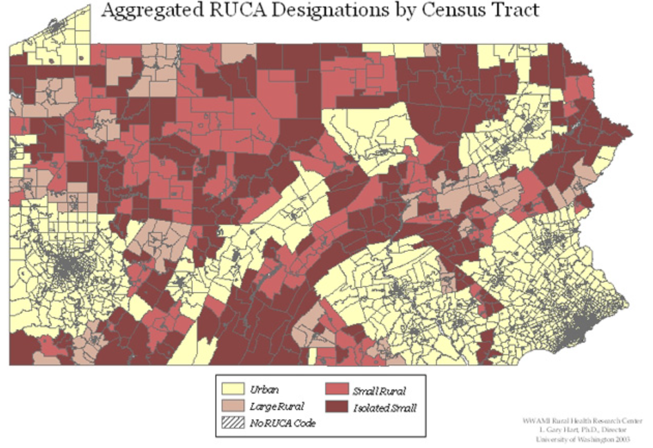
Workforce Challenges in Rural PA
Current state: Widespread rural healthcare workforce shortages
Projection: Worsening of rural healthcare workforce shortages
Notes:
https://depts.washington.edu/uwruca/ruca1/ruca-state-maps11.php
RUCA = rural urban commuting area

Slide 4
Current State: PA Health Care Workforce Shortages

Slide 5
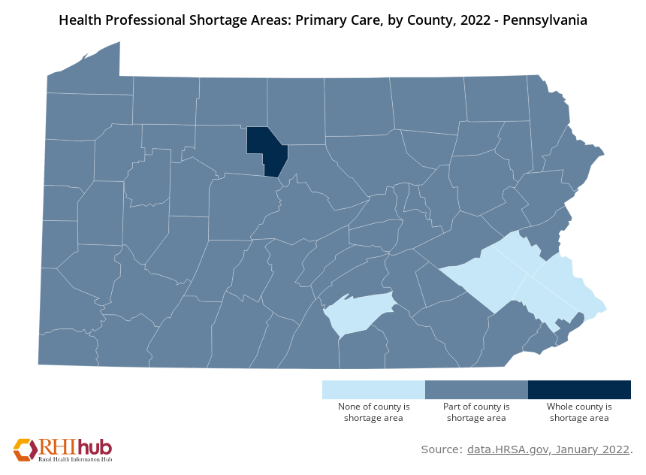
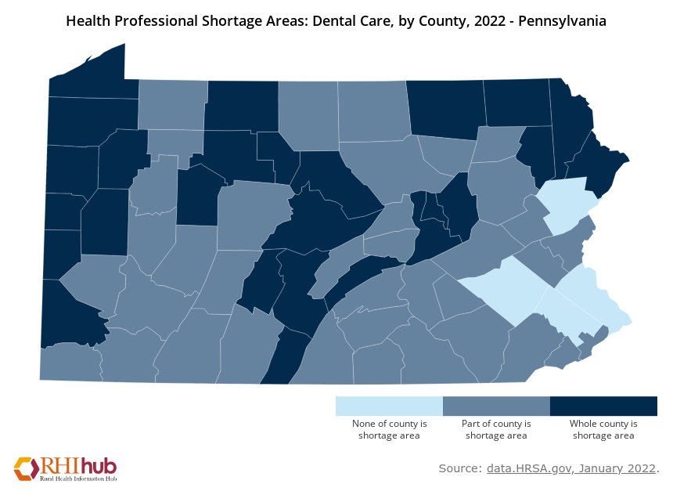
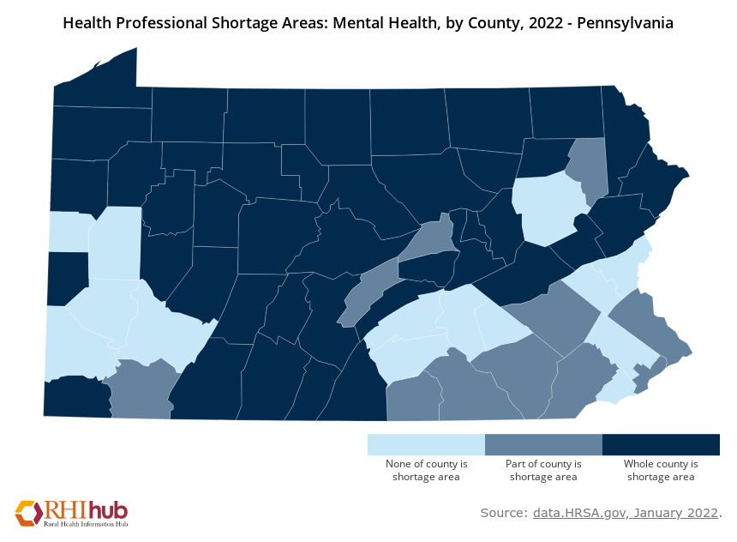
Widespread Professional Shortage Areas
Primary Care HPSAs, 2022
Dental HPSAs, 2022
Mental Health HPSAs, 2022
Every rural county in PA has at least some primary care shortage area.
Most rural counties in PA have at least some dental shortage area.
Most rural counties in PA are entirely a mental health shortage area.
Notes:
According to the Hospital Association of PA: PA has twice as many medically underserved areas as the average state and 1/3 more HPSAs compared with the average State.
Since 2005, PA has closed 5 rural hospitals, leaving 18. The impact means that patients’ travel further for specialist care…it also means they are in greater need of well-trained generalists, in particular family physicians, because that is who the patients are seeking out for care.
https://stacker.com/pennsylvania/see-how-many-rural-hospitals-pennsylvania-have-closed-2005
https://familymedicine.uw.edu/rhrc/2021/09/11/geographic-access-to-health-care-for-rural-medicare-beneficiaries-an-update-and-national-look/
While PA’s dentist-to-population ratio is favorable, the actual picture is that the dentists, like physicians, skew heavily toward suburban and urban locations. Furthermore, only 23% of PA’s general dentists accept Medicaid. https://paoralhealth.org/wp-content/uploads/2020/06/Pennsylvania-Oral-Health-Plan-2020-2030-Stakeholder-Draft.pdf
https://www.haponline.org/Flipbooks/Workforce/index.html

Slide 6
Notes:
https://familymedicine.uw.edu/rhrc/wp-content/uploads/sites/4/2020/06/RHRC_DB167_Pennsylvania.pdf
The blue bars represent National and PA urban primary care clinicians. PA has a higher proportion of urban primary care clinicians compared to national figures.
But the Green bars tell a different story: The primary care workforce in rural PA is comprised almost entirely of family physicians, NPs, and PAs
The disparity between urban and rural remains significant.

Slide 7
1,600 Primary Care Clinicians Needed to Bring Rural up to Par With Urban
Notes:
https://familymedicine.uw.edu/rhrc/wp-content/uploads/sites/4/2020/06/RHRC_DB167_Pennsylvania.pdf
This compares Urban and Rural primary care clinicians in Pennsylvania.
Note the gap to bring PA Rural up to par with PA Urban equates to approximately 1,600 clinicians.

Slide 8
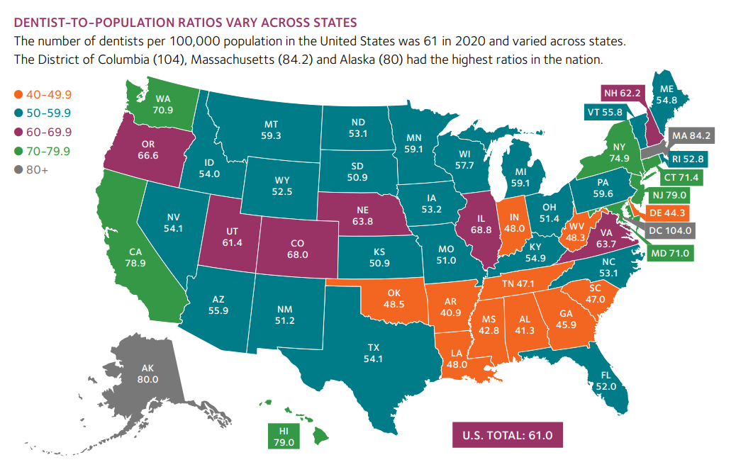
Source: American Dental Association Health Policy Institute
Notes:
Pennsylvania is in the second lowest quintile for dentist-to-population ratios across U.S. states.
https://www.ada.org/-/media/project/ada-organization/ada/ada-org/files/resources/research/hpi/hpigraphic_0221_1.pdf?rev=1829a4f788c14974a1ac89ff1e288c0f&hash=A27C6AD199EB6FCAB15DB069BAF0CC85

Slide 9
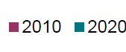
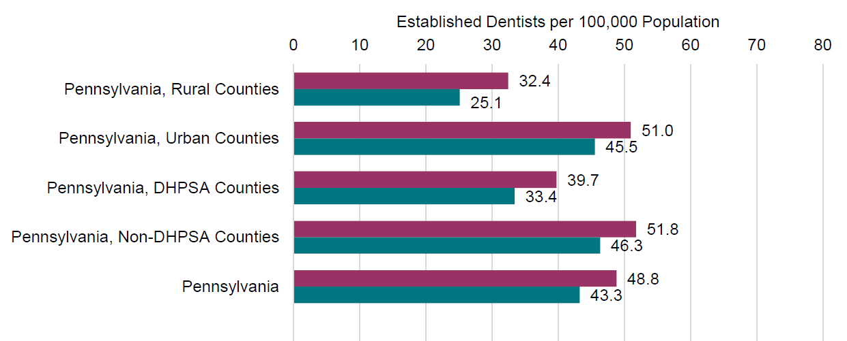
Declining Dentists in PA
Access to Dental Care in Pennsylvania, An ADA Health Policy Institute Analysis for the Pennsylvania Coalition for Oral Health, July 2021
Notes:
There is a decline across-the-board over the past 10 years in the number of dentists per 100,000 population in PA. The lowest ratio is again seen in rural areas…almost ½ the # of dentists per 100,000

Slide 10
Notes:
The workforce disparities between urban and rural mental health clinicians is even more dramatic.

Slide 11
Projected Health Care Workforce Shortages
Notes:
The current state in rural is projected to worsen over the next decade.

Slide 12
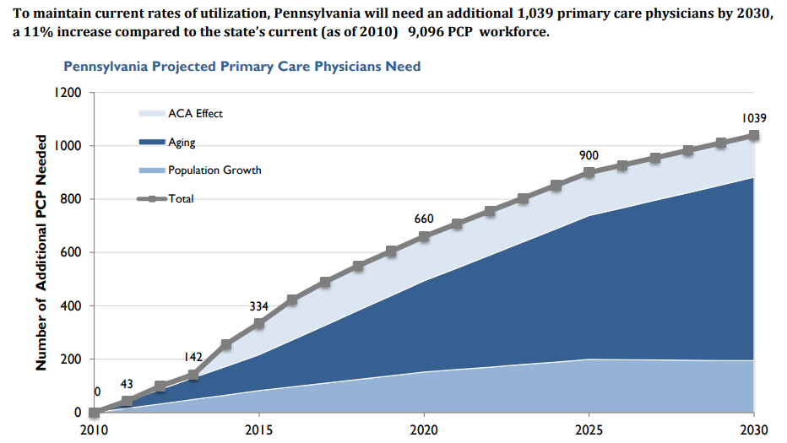
To Maintain the Current Rates of Primary
Care Physicians to Population…
Baby Boomers
Source: Robert Graham Center, Primary Care Physician Workforce Projections 2010-2030
Notes:
I already mentioned that to bring the primary care workforce in rural PA up to par with urban we will need about 1,600 clinicians.
At the state level, just to maintain the current rate of healthcare utilization, PA will need an additional 1000 primary care physicians by 2030. Medical school graduates are not keeping up with the pace of the need.

Slide 13
An Aging Physician Population
In 2014, 30% of PA physicians were > 60, and in 2021…
In 2014, 31% of PA FPs were > 60, and in 2021…
34%
39%
2021 State Physician Workforce Data Reports, Association of American Medical Colleges
In 2015, more rural (30%) than urban (26%) physicians anticipated leaving direct patient care in Pennsylvania in less than six years.¹ COVID-19 may have exacerbated this.
¹Joint State Government Commission, 2015
Notes:
Specific to PA
34% are > 60 years…up from 30%
FPs are even older than peers…38% > age 60 up from 30% 2014
Primary care is rapidly getting older in Pennsylvania…younger generations are not replacing

Slide 14
Nurses Are Aging Too:
One in Five to Retire in Next 5 Years
[PA RN 2013 = 6%]
4.4%
14.6%
19.0%
2004-05 and 2012-13: Joint State Government Committee, June 2015.
U.S. RN/LPN: National Council of State Boards of Nursing 2020 National Nursing Workforce Survey
Notes:
Nursing data: 2004-5, 2012-13 PA DOH report
National data last two
2013…PA RNs 6% > 65 years
Likely our data is even worse than US data…but data is not available
the decline in rural practicing RNs occurred more rapidly among younger RNs (under age 40) (from 18.1 percent to 13.7 percent) than among RNs over age 40 (from 16.4 percent to 14.9 percent). If this decrease continues, it will threaten access to care among the nation’s rural population. National Academies of Sciences, Engineering, and Medicine. 2021. The Future of Nursing 2020-2030: Charting a Path to Achieve Health Equity. Washington, DC: The National Academies Press. https://doi.org/10.17226/25982.

Slide 15
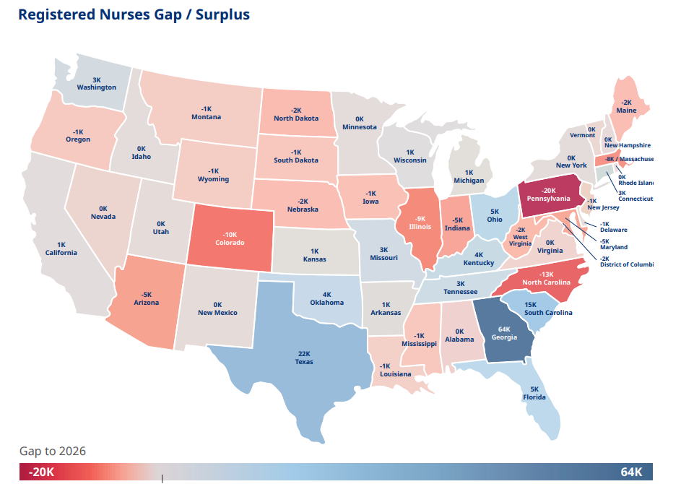
Notes:
According to a 2021 Mercer report, Pennsylvania will lead the nation in RN shortages over the next 5 years.
Pre-pandemic demand for RNs in Pennsylvania was projected to increase 13% from 2016 to 2026, with 10,510 job openings/year.²
https://www.mercer.us/content/dam/mercer/assets/content-images/north-america/united-states/us-healthcare-news/us-2021-healthcare-labor-market-whitepaper.pdf
According to HRSA, PA will rank #2 by 2030 for LPN shortage.
Many rural hospitals have reported severe nursing shortages during COVID-19 pandemic at legislative hearings.³
² https://www.haponline.org/Flipbooks/Workforce/index.html
³ http://www.pagoppolicy.com/pasthearings

Slide 16
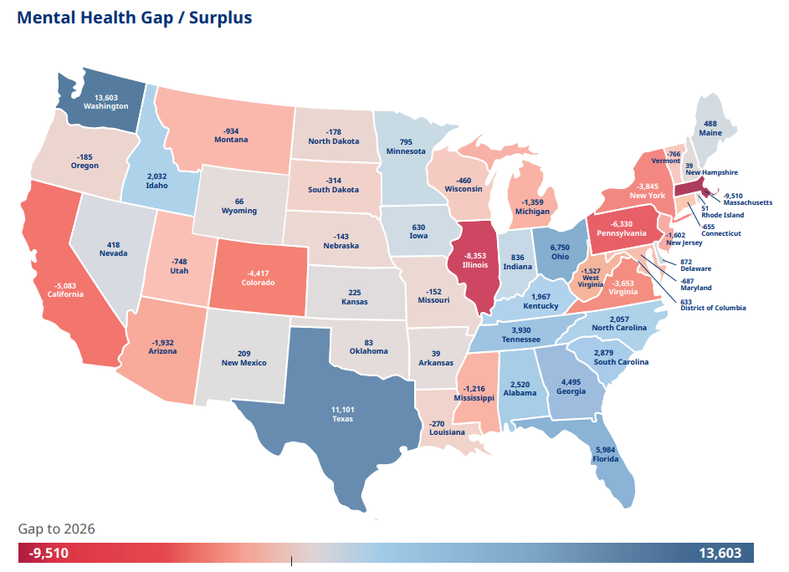
Notes:
Pennsylvania will also be in the top states for mental health labor deficits. largely due to workers that are rapidly leaving mental health professions.
https://www.mercer.us/content/dam/mercer/assets/content-images/north-america/united-states/us-healthcare-news/us-2021-healthcare-labor-market-whitepaper.pdf

Slide 17
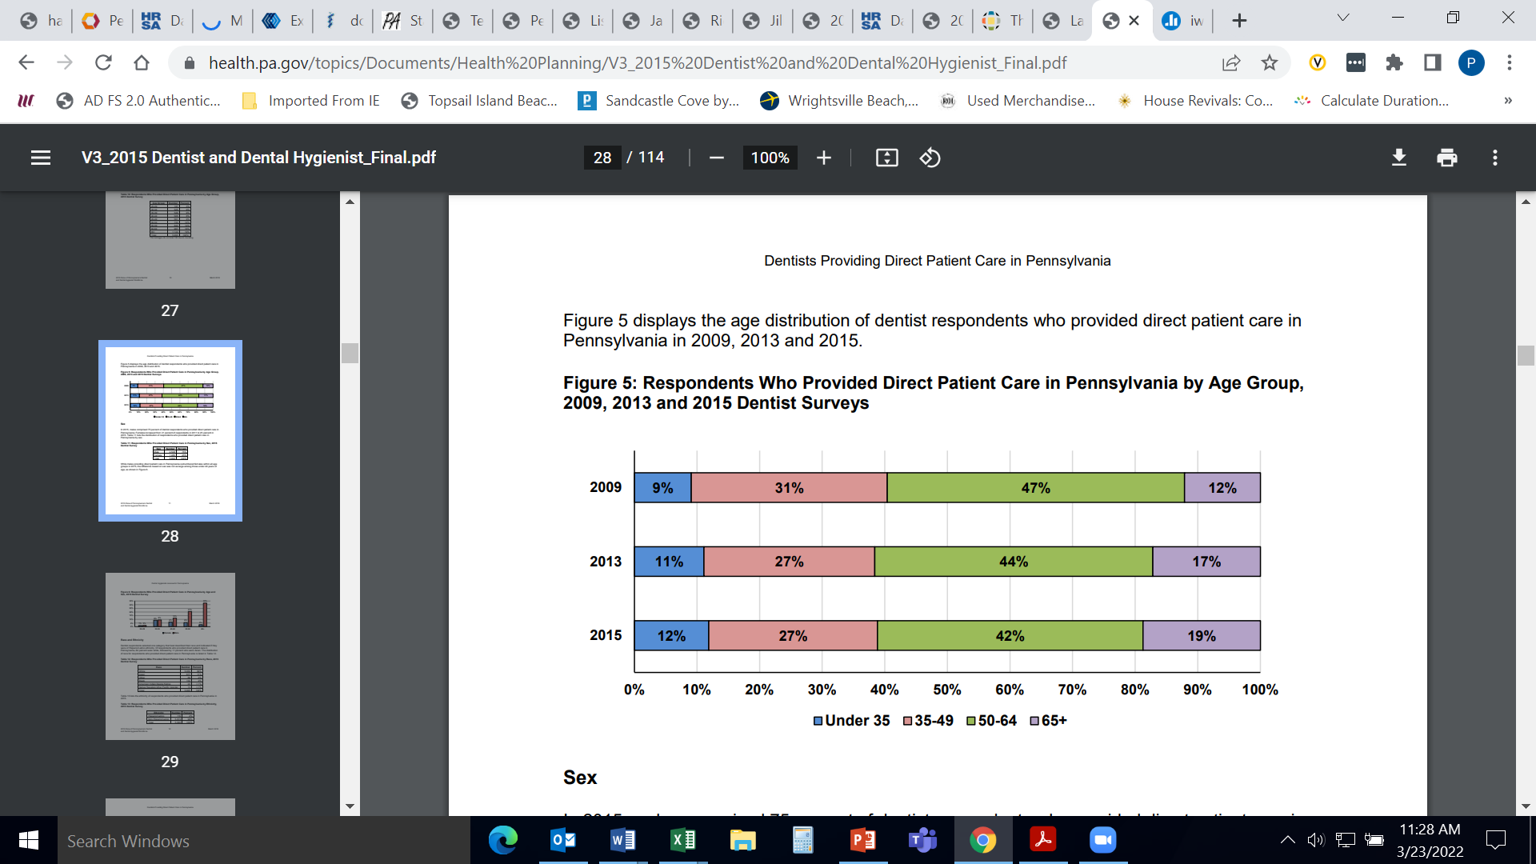
Dentists Also Are Aging, Nearing Retirement
Pennsylvania Department of Health, Bureau of Health Planning, Division of Plan Development, 2018
Notes:
The average age of dentists in rural Pennsylvania counties (53.6 years old) was more than a year older than the average age of dentists in urban Pennsylvania counties (52.2 years old) in 2015.

Slide 18
Quick Summary
Primary care in rural areas is being provided most by Family Physicians, Nurse Practitioners, and Physician Assistants.
Rural areas continue to experience chronic and disproportionate health care workforce shortages.
  Disparities in mental health, dentistry, and RNs are the most dramatic.
Shortages are projected to increase.
  As an aging workforce retires (especially family medicine physicians—the main physician workforce for rural PA—RNs, LPNs and dentists).
  And with inadequate replacement numbers.
Notes:
RNs disparity????

Slide 19
Future rural health care workforce will rely on…
Rural students entering health professions
Rural training opportunities for health professional students
Rural opportunities for professional practice and personal fulfillment
Notes:
The research is demonstrating that rural students are far more likely to practice in rural areas…but we are not seeing rural students pursuing health professional degrees at nearly the same rates as their urban counterparts.
Exposure exposure exposure—that’s key in attracting future health clinicians to rural areas.
Welcoming community that expresses real interest in having the person come and live in their area, that showcases their strengths of rural living, aligns with the mission of an area in need, strong personal relationships with community members, valued member of the community, opportunities for leadership, loan repayment options and other incentives such as assistance with finding spousal employment.

Slide 20
Happy to Answer Questions and Discuss Workforce Issues Now or Later
nfredrick@pennstatehealth.psu.edu

